Slide 1

Quantifying SARS-CoV-2 transmission suggests epidemic control with digital contact tracing
by Luca Ferretti, Chris Wymant, Michelle Kendall, Lele Zhao, Anel Nurtay, Lucie Abeler-Dörner, Michael Parker, David Bonsall, and Christophe Fraser
Science
Volume 368(6491):eabb6936
May 8, 2020
Copyright © 2020 The Authors, some rights reserved; exclusive licensee American Association for the Advancement of Science. No claim to original U.S. Government Works

Slide 2
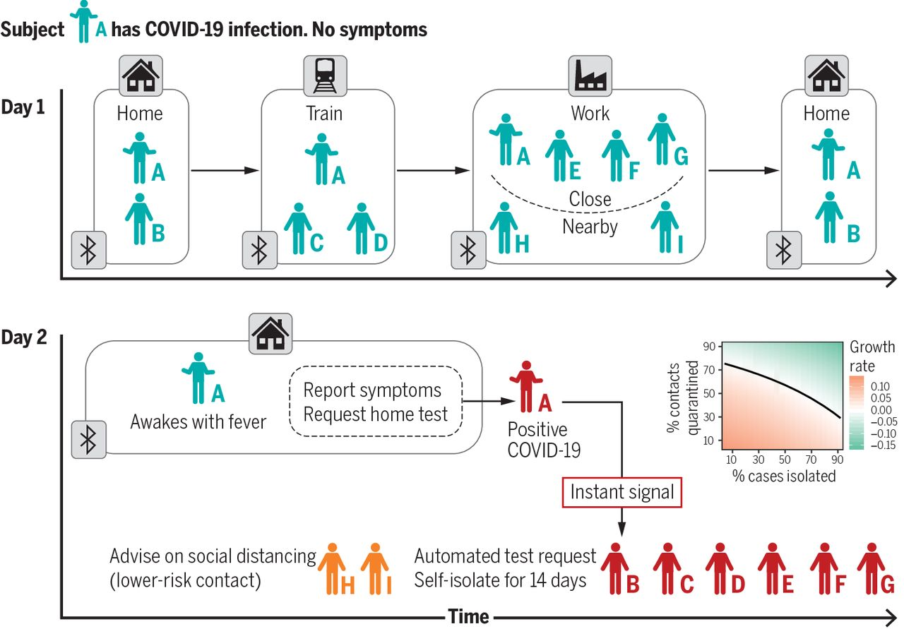
Instant contact tracing can reduce the proportion of cases that need to be isolated and contacts who need to be quarantined to achieve control of an epidemic.
Luca Ferretti et al. Science 2020;368:eabb6936
Copyright © 2020 The Authors, some rights reserved; exclusive licensee American Association for the Advancement of Science. No claim to original U.S. Government Works
Notes:
Instant contact tracing can reduce the proportion of cases that need to be isolated and contacts who need to be quarantined to achieve control of an epidemic. Subject A becomes symptomatic after having had contact with other people in different settings the day before. Contacts are notified and quarantined where needed. In the inset, the green area indicates the success rates needed to control an epidemic with R₀ = 2 (i.e., negative growth rates after isolating cases and quarantining their contacts).

Slide 3
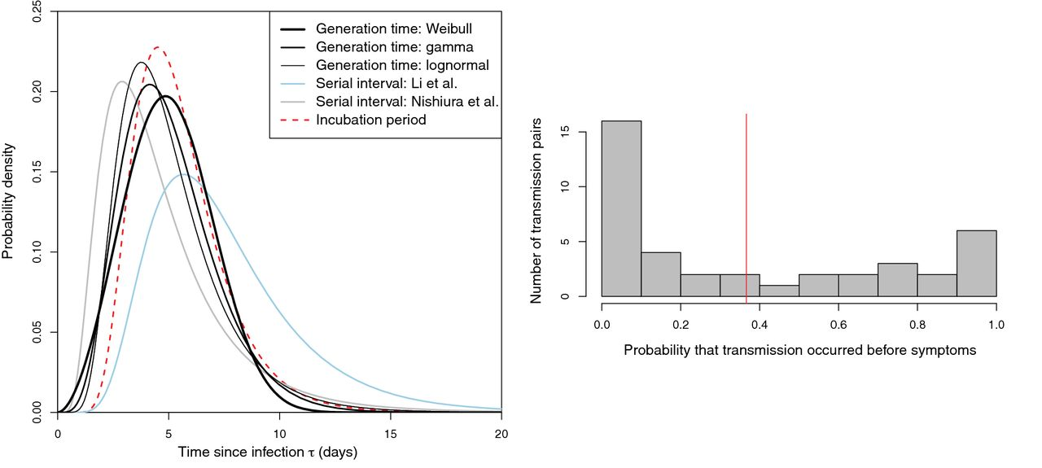
Fig. 1 Quantifying transmission timing in 40 transmission pairs.
Luca Ferretti et al. Science 2020;368:eabb6936
Copyright © 2020 The Authors, some rights reserved; exclusive licensee American Association for the Advancement of Science. No claim to original U.S. Government Works
Notes:
Quantifying transmission timing in 40 transmission pairs. Left: Our inferred generation time distributions, in black; thicker lines denote higher support for the corresponding functional form, with the Weibull distribution being the best fit. For comparison, we also include the serial interval distributions previously reported by Li et al. (12) (light blue) and Nishiura et al. (22) (gray) and the incubation period distribution we used here, from Lauer et al. (21) (dashed red line). Right: Distribution of the posterior probability of presymptomatic transmission for each of the 40 transmission pairs. The red vertical line shows the mean probability.

Slide 4
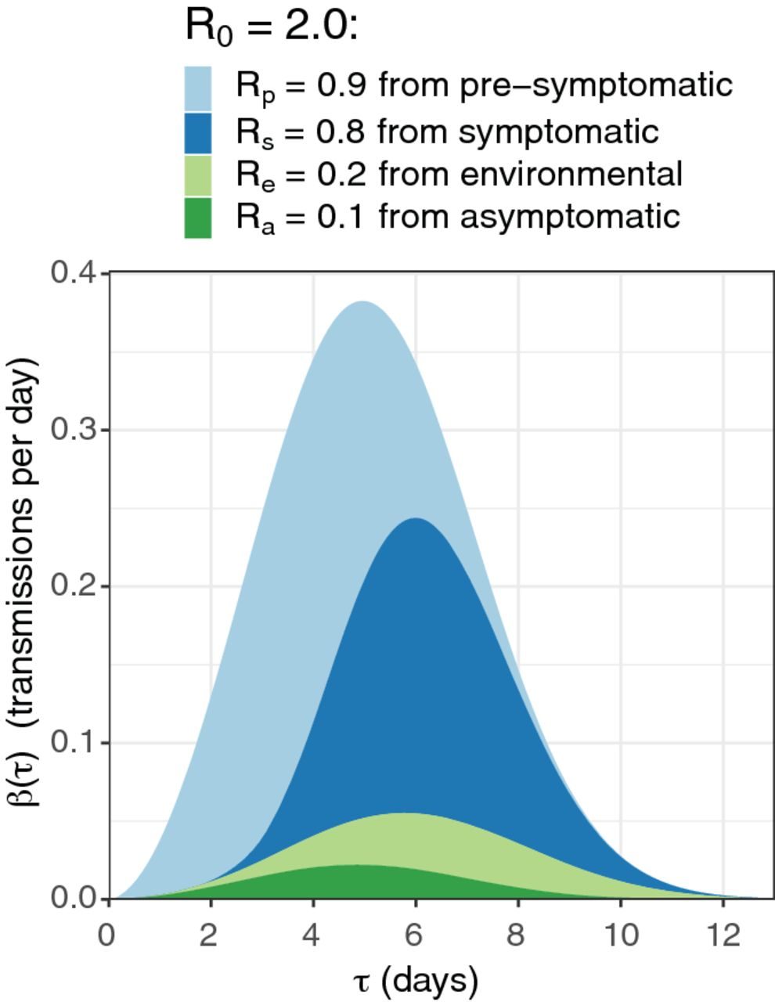
Fig. 2 Our model of infectiousness.
Luca Ferretti et al. Science 2020;368:eabb6936
Copyright © 2020 The Authors, some rights reserved; exclusive licensee American Association for the Advancement of Science. No claim to original U.S. Government Works
Notes:
Our model of infectiousness. The average infectiousness (rate of infecting others), β, is shown as a function of the amount of time since infection, τ. The total colored area found between two values of τ is the number of transmissions expected in that time window. The total colored area over all values of τ is the number of transmissions expected over the full course of one infection (i.e., the basic reproduction number R₀). The different colors indicate the contributions of the four routes of transmission, so that the total area of one color over all values of τ is the average number of transmissions via that route over the whole course of infection: R_{P}, R_{S}, R_{E}, and R_{A} for presymptomatic, symptomatic, environmentally mediated, and asymptomatic transmission, respectively. Note that the colors are stacked on top of one another (i.e., the lower colors are not in front, and the higher colors are not behind and partially obscured). Values are rounded to one decimal place. Stopping the spread of disease requires reduction of R to less than 1: blocking transmission, from whatever combination of colors and values of τ we can achieve, such that the total area is halved.

Slide 5
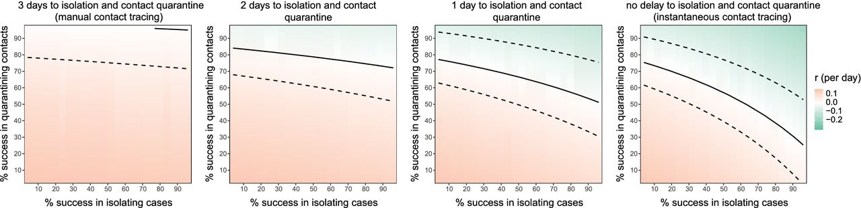
Fig. 3 Quantifying intervention success.
Luca Ferretti et al. Science 2020;368:eabb6936
Copyright © 2020 The Authors, some rights reserved; exclusive licensee American Association for the Advancement of Science. No claim to original U.S. Government Works
Notes:
Quantifying intervention success. Heat map plot shows the exponential growth rate of the epidemic r as a function of the success rate of instant isolation of symptomatic cases (x axis) and the success rate of instant contact tracing (y axis). Positive values of r (red) imply a growing epidemic; negative values of r (green) imply a declining epidemic, with greater negative values implying faster decline. The solid black line shows r = 0 (i.e., the threshold for epidemic control). The dashed lines show uncertainty in the threshold due to uncertainty in R₀ (see figs. S15 to S17). The different panels show variation in the delay associated with the intervention, from initiation of symptoms to case isolation and quarantine of contacts.

Slide 6
Fig. 4 A schematic of app-based COVID-19 contact tracing.
Luca Ferretti et al. Science 2020;368:eabb6936
Copyright © 2020 The Authors, some rights reserved; exclusive licensee American Association for the Advancement of Science. No claim to original U.S. Government Works
Notes:
A schematic of app-based COVID-19 contact tracing. Contacts of individual A (and all individuals using the app) are traced using low-energy Bluetooth connections with other app users. Individual A requests a SARS-CoV-2 test (using the app) and that person’s positive test result triggers an instant notification to individuals who have been in close contact. The app advises isolation for the case (individual A) and quarantine of the individual’s contacts.

